Slide 1
Al – Iman College
As Salam O Aalaikum wa Rahmatullahi wa barakatu
We would like to welcome all the parents, staff members and those who are present at this prestigious event. we would like to showcase our library and the different programs, such as collection & development, circulation and the variety of literacy & numeracy programs. To cater the demands from the students and the community.

Slide 2
Hadith on Knowledge

Slide 3
Mission statement of our Library
Our mission is to ensure students and staff access to high quality library resources , by ensuring that all students are equipped with the research and literacy skills required as life long learners.

Slide 4
Vision statement of our Library
Libraries are vital for schools and students. A place of learning, collaboration, expression, and creativity, well-equipped libraries are flexible, bustling with technology. Our mission is to ensure that all children have equitable access to the library.

Slide 5
Our Depository
Fiction
Non – Fiction
Teaching Aids
Guided Readers
Posters
Kits
Islamic Studies – Fiction and Non-Fiction
Scholarly Collection on Islamic and religious studies.

Slide 6
Our Services
Collection and Development
Circulation
ICT – Information Communication and Technology.
Literacy and Numerary Programs
Take Home Reading Program
Guided Reading Program
DEAR Drop Everything and Read .
Book Week
Premier's Reading Challenge
Our library is equipped with an IT Lab and computers.

Slide 7
Collection and Development
Selection of the resources is principally undertaken by the managing panel , academic staff and the librarian to ensure that material is relevant to the Al - Iman college teaching and learning ethos.
The acquisition of the resources are coordinated and managed in the most cost-effective manner across the curriculum and library system.
The first priority for the acquisitions budget is the provision of access to texts prescribed for courses offered by Al Iman college.
AL–Iman college library is enriched with scholarly / Uloom Deen books housed within the library.

Slide 8
Circulation
Library circulation comprises the activities such as lending and returning of the library resources.
Al - Iman college library uses an automated library system to circulate fiction , non fiction and reference collection .
Students use our library and the resources for research, reading and other library related activities
Staff and students borrow & return books from our library on a daily basis.

Slide 9
ICT – Information & Communication Technology
AL – Iman college uses ICT in teaching, creating, evaluating, search and communicate.
Students are taught to use multi media , use internet or online learning resources , word processing during their learning process.
Computers & IT Lab : Our Library is equipped with number of computers and a IT lab . Students schedule their time table to make use of these facilities .
Online teaching resources: Students are encouraged to use on - line technology by performing on line tests like Mathletics, research on academic projects proposed by teachers .
E - books : Apart from the curriculum text books number of online resources are subscribed for the students use. Electronic books contain digital form of text and images. Online teaching resource’s are subscribed across the curriculum.

Slide 10
Literacy and Numeracy
Literacy : Literacy encompasses the knowledge and skills students need to access, understand , analyse and evaluate the information acquired disseminated by the teachers . Literacy encompasses the knowledge and skills students need to access, understand, analyse and evaluate information, make meaning, express thoughts and emotions, present ideas and opinions, interact with others and participate in activities at school and in their lives beyond school.
In Australian Curriculum students are encouraged and taught to become numerate as they develop knowledge and skills to use mathematics confidently across the other learning spectrum . Numeracy encompasses the knowledge , skills ,behaviour and disposition that students need to use mathematics in a wider range. Numeracy acts an important aspect in students learning

Slide 11
Literacy - Key Ideas
Comprehending text through
Listening Reading and Viewing
Composing Text through
Speaking , writing and Creating.
Grammar Knowledge
Visual knowledge

Slide 12
Numeracy – Key Ideas
Using Measurements
Interpreting numbers
Estimating and calculating with numbers.
Reasoning
Using fractions , decimals .
Recognizing pattern's and relationships.

Slide 13
Take Home Reader’s Program
Take home readers program, is integral part of our school’s literacy program . All the students are expected to receive and read a book every weeknight at home. Teachers regularly assess students reading skills and grades their next level. It is crucial to remember that this program should be fun and easy experience.
A child’s journey towards literacy involves learning to speak, listen, read , understand , watch, write and draw.

Slide 14
Take Home Reading Program
Take-Home Reading is a special program for students that helps every child become a better reader. Since Learning to read takes a lot of practice, parents can help their children by listening to their children read.
Take Home Reading Programs help parents informed about their children reading progress and provide a structure for parents to enhance the reading skills to become a fluent reader.

Slide 15
Take Home Reading Program
Teacher select book based on students cognitive levels . Students are given books everyday to read , return and reborrow.
Students are also encouraged to use the library resources for research from Fiction, Non-Fiction , curriculum and Islamic Studies .
The Management at Al- Iman college tries its best to procure books based on the student's interest .

Slide 16
What is Guided Reading Program?
Guided reading is an instructional approach that involves a teacher working with a small group of students who demonstrate similar reading behaviour's and can read similar levels of texts.
The text is easy enough for students to read with your skilful support; it offers challenges and opportunities for problem solving, but is easy enough for students to read with some fluency.
Guided reading gives students the an opportunity to apply the strategies they already know to use the text. The educator provides support, but the ultimate goal is independent reading.

Slide 17
Purpose of Guided Reading Program ?
Teachers select books that students can read with about 90 percent accuracy. Students can understand and enjoy the story because it's accessible to them through their own strategies, supported by class teacher.
They focus on meaning but also use problem-solving strategies to figure out words they don't know, deal with difficult sentence structure, and understand concepts or ideas they have never before encountered .

Slide 19
Drop Everything and Read
This program is a structured reading program that allows students to engage in sustained silent reading for fifteen minutes at the start of Period 3 on scheduled days.
Since Reading is integral to the educational development of our students. Finding ways to provide students with an opportunity to engage in a regular reading program is of great importance at Al – Iman College.

Slide 20
Premier’s Reading Challenge
To Idents reading skills through engaging in regular, sustained
The Premier's Reading Challenge is a literacy engagement program that was introduced by the Premier in 2004 .
It encourage students to read more books and enjoy reading
Improve literacy levels.
The Challenge requires students to read up 12 books.

Slide 21
BOOK WEEK
Book Week is an annual celebration of books written for young and old students. Once again, the focus is to inspire a love of reading . Schools and libraries host number of activities to encourage and enhance the literacy by connecting the readers with books and celebrate the joy of reading. Parents are invited to read along with their children .
Reading makes your children smarter.
Reading Increase creativity and Imagination.
Improves memory.
Improves Vocabulary and English.
Increase Desire towards achieving goals.

Slide 22
Acknowledgment
We would like thank our librarian Ms. Khurrathulaain
For initiating this presentation and making us feel proud and learn the presentation skills.
MS. Aain believes in mentoring the students , since mentoring aims to build confidence, develop resilience and raise aspirations , rather than to develop specific academic skill and knowledge.
Jazaka Allaho Khairan

Slide 23
Popular Books
Islamic Studies
Fiction & Non- Fiction

Slide 24
Fiction – Islamic Studies

Slide 25
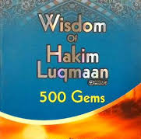
Non – Fiction

Slide 26
Non-Fiction Islamic Studies.

Slide 27
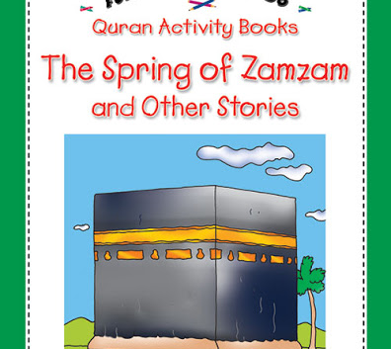
Non – Fiction Islamic Studies

Slide 28
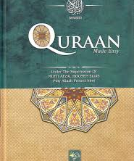
Islamic Studies

Slide 29
English Mathematics Science Technology Health and Physical Education Religion and Islamic Studies
Across
the Curriculum.

Slide 30
English

Slide 31
Mathematics

Slide 32
Science

Slide 33
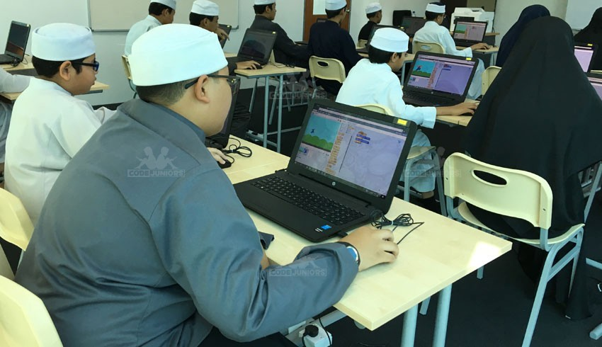
Technology

Slide 34
Health and Physical Education

Slide 35
Islamic Studies

Slide 36
Uloom al-Deen

Slide 37
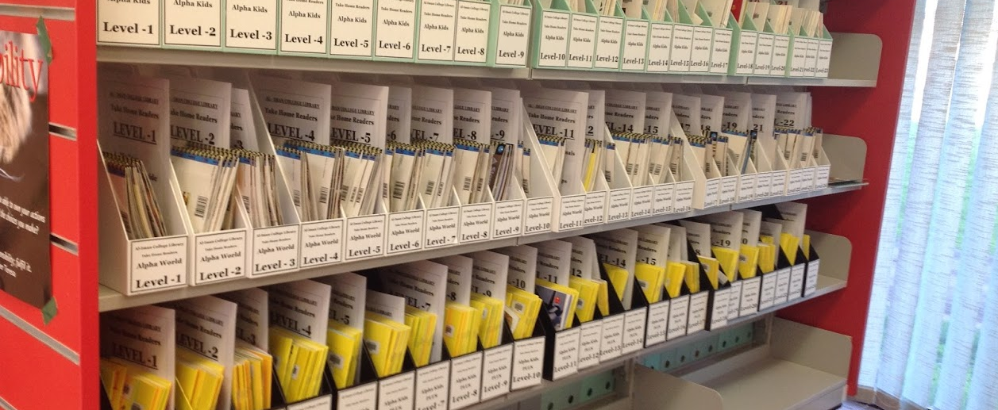
Take Home Readers & Classification

Slide 38
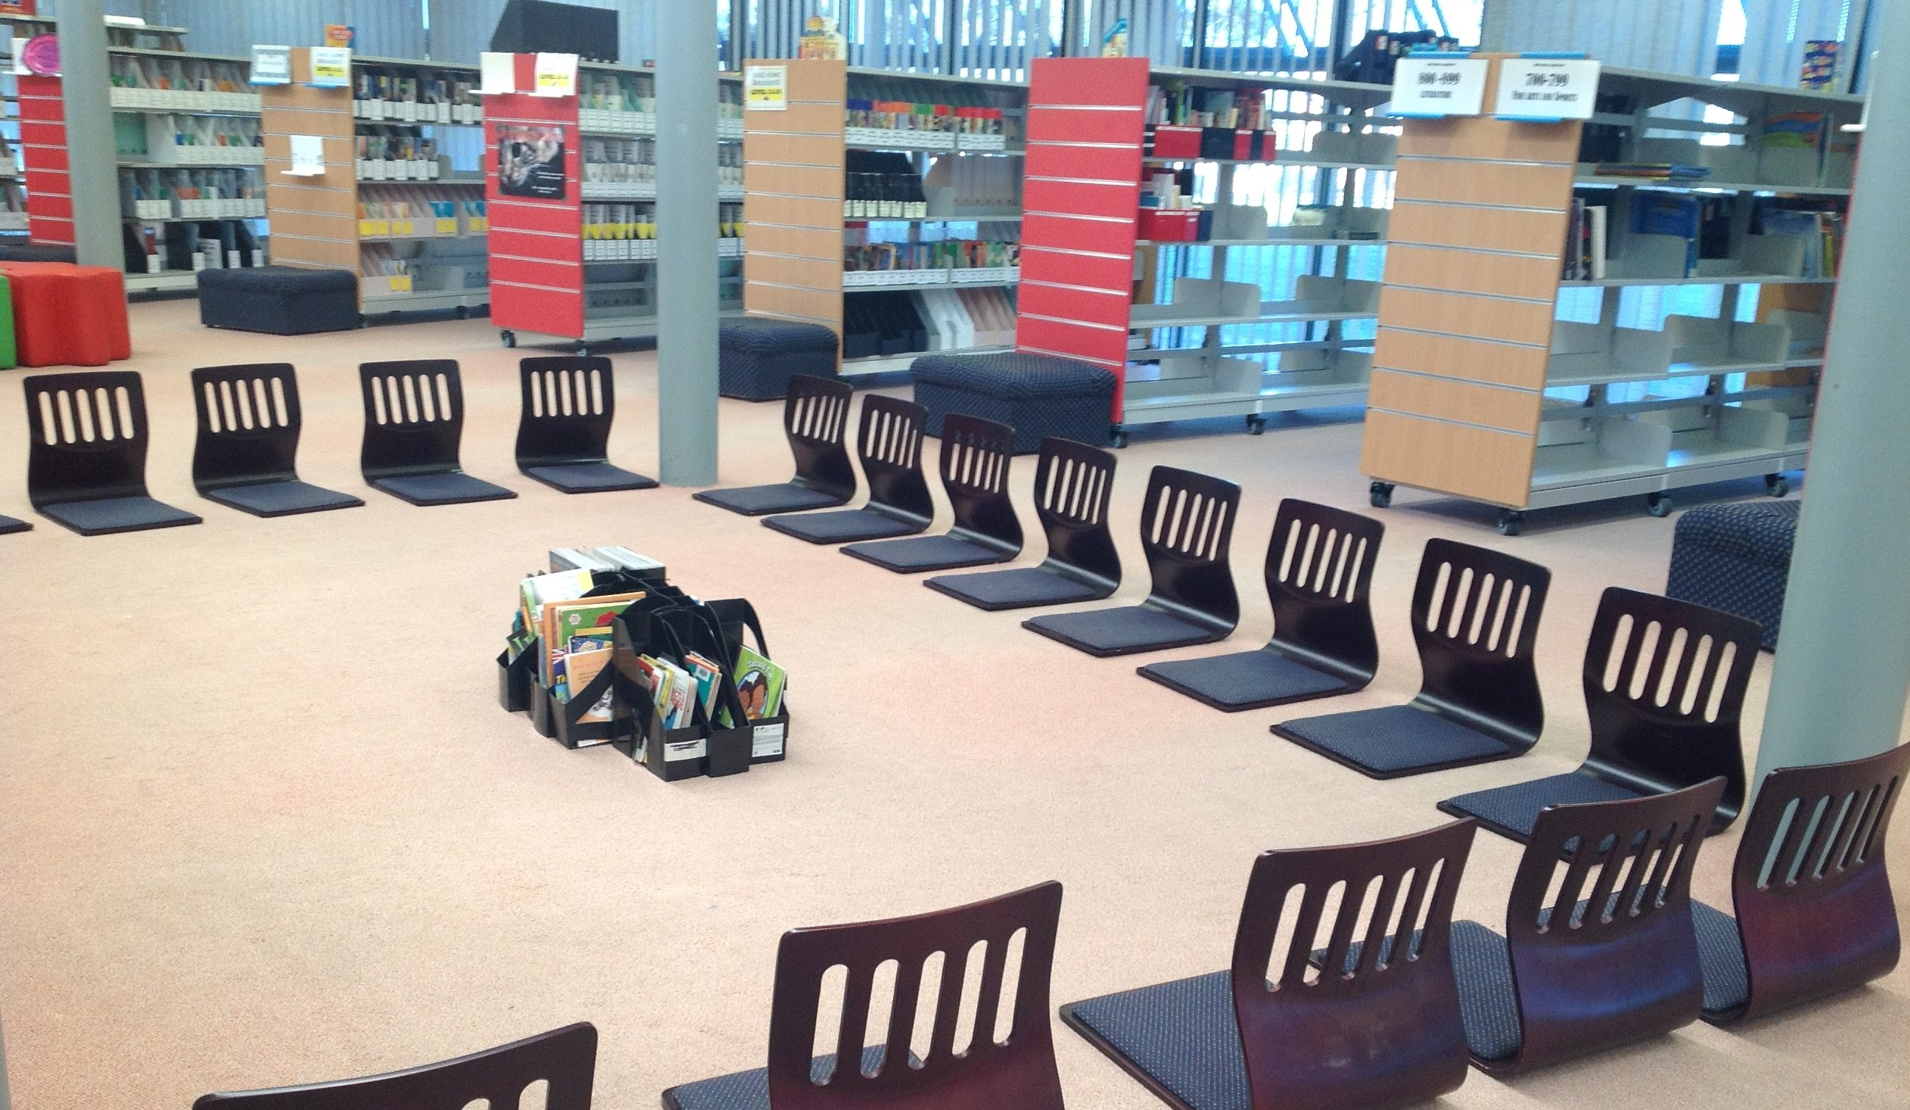
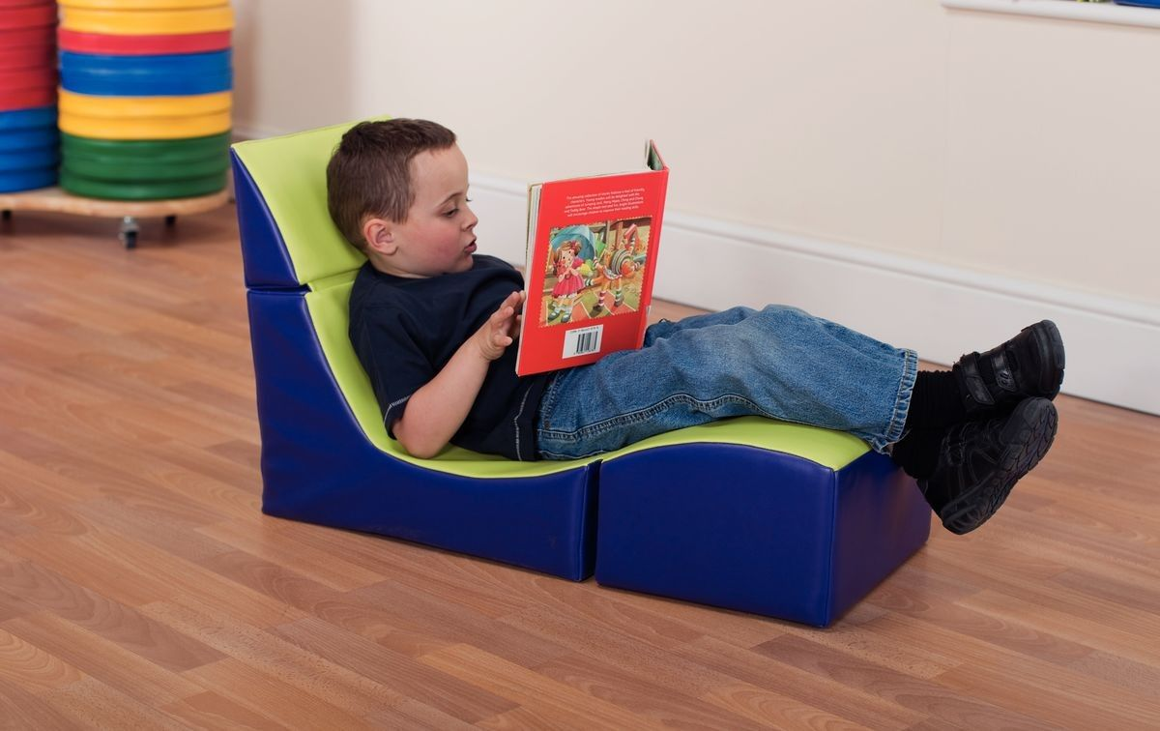
Ergonomics in Our Library

Slide 40
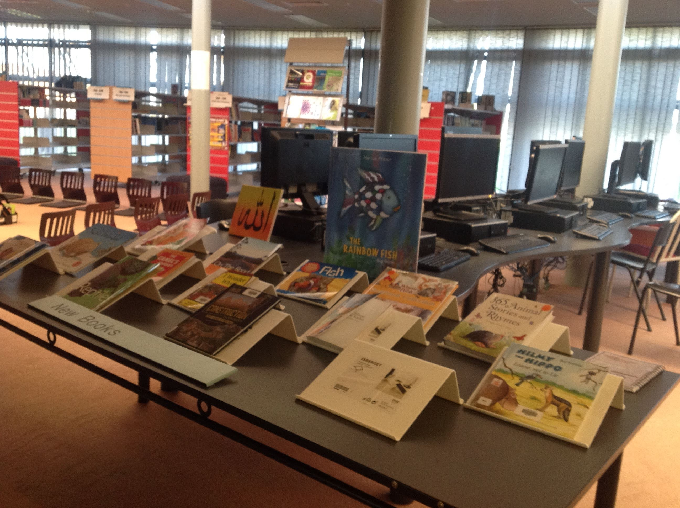

Slide 41
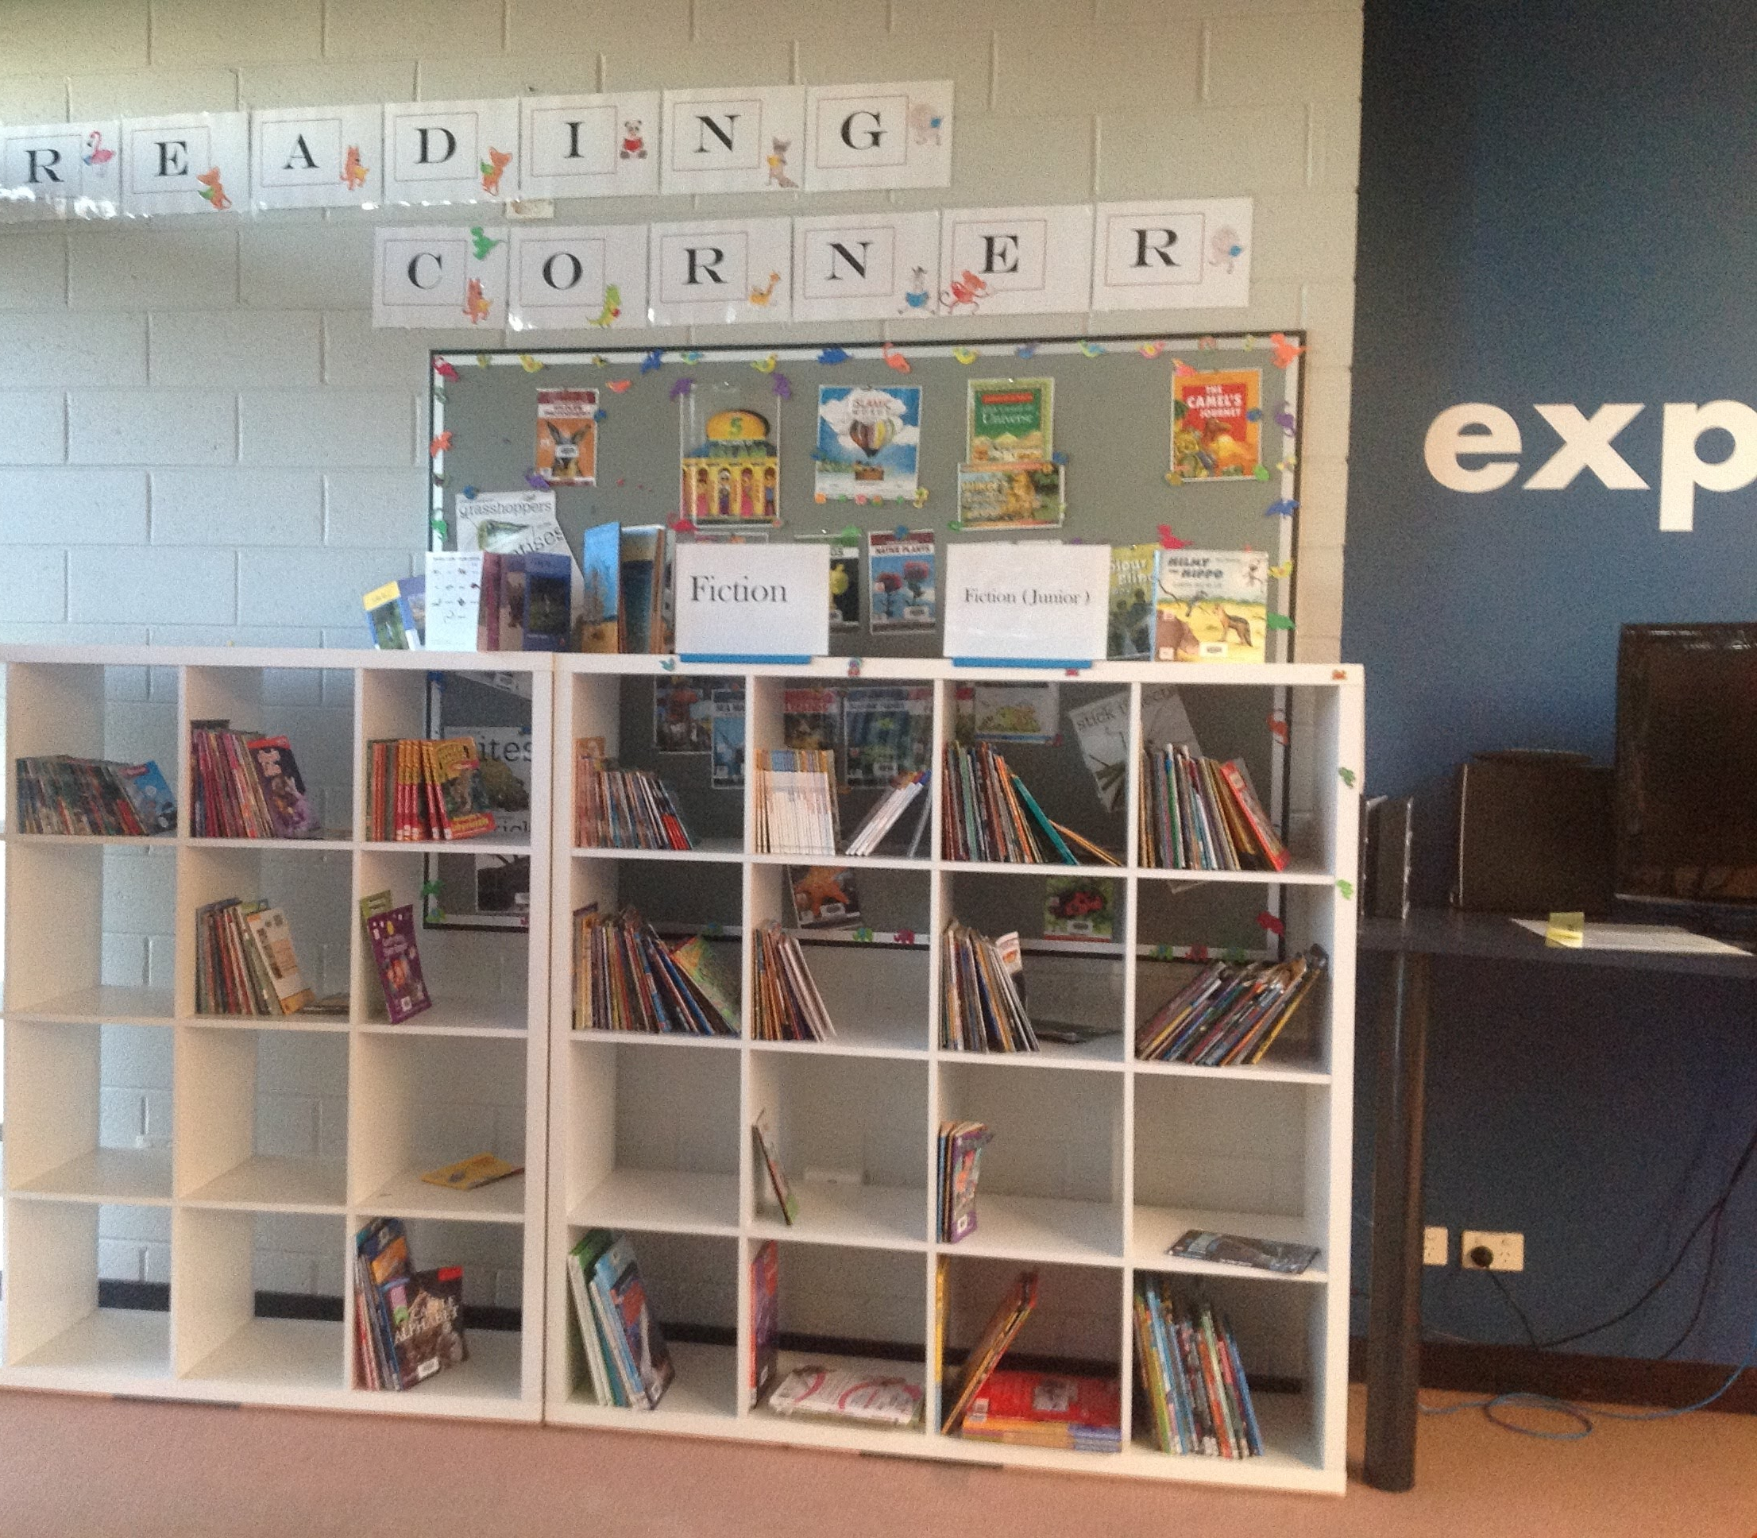
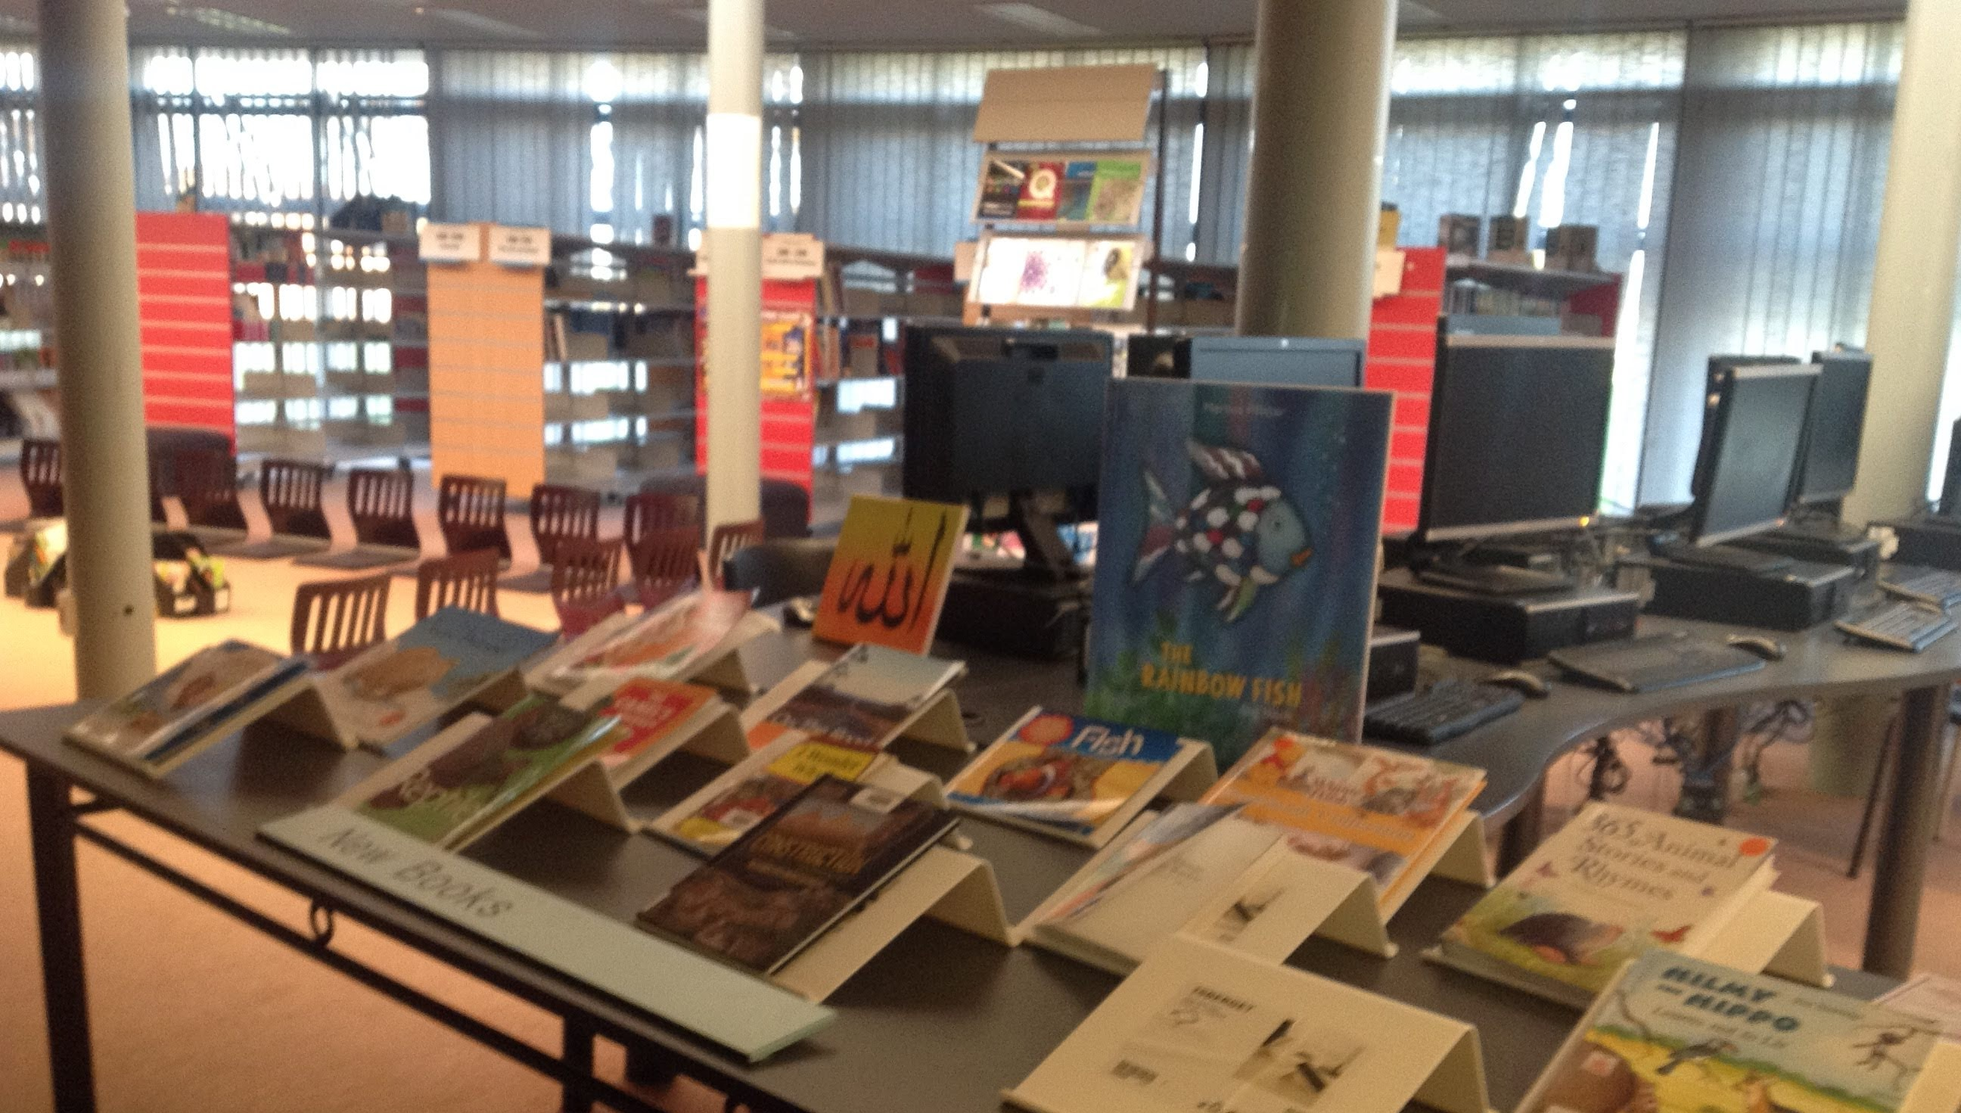
Guided Reading - Brainstorming

Slide 42
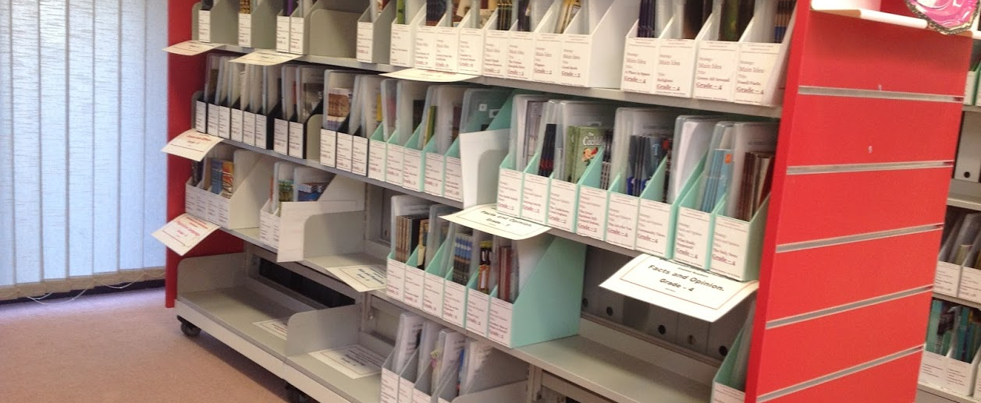
Guided Reading Kits

Slide 43
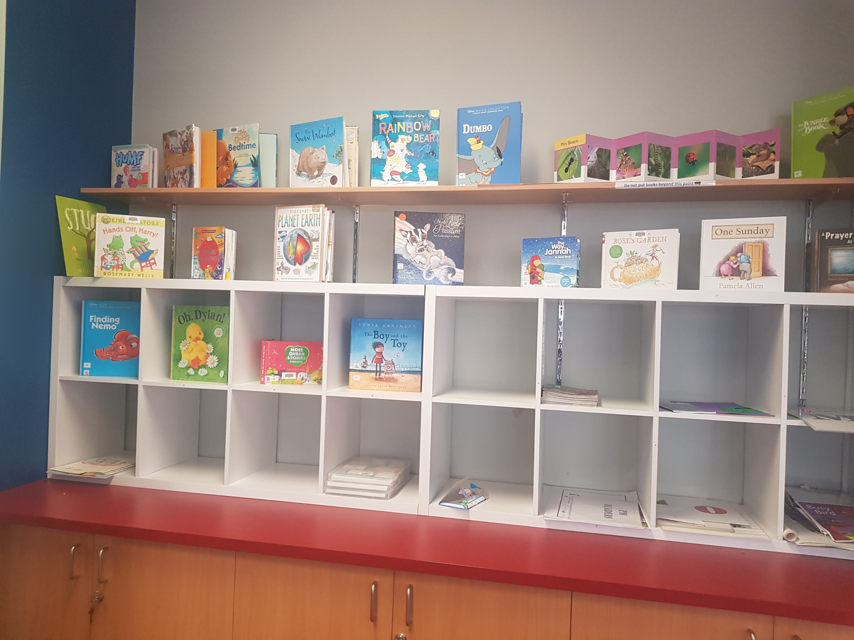

Slide 44
Please feel free to see me in the librarian if you have any comment, concern.

